Slide 1

USPW (0368-3544) Twitter Bot Detector Final Presentation
Stav Ben Tov, Tamir Davidi

Slide 2

Motivation
Inform users which accounts are likely to be bots in order to help them make better decisions and promote a safer and more trustworthy environment on Twitter.

Slide 3
Prior work
In our work, we relied on the article:
“Scalable and Generalizable Social Bot Detection through Data Selection”[1]
This paper proposed a ML model, which is based on user’s metadata, in order to identify Twitter bots.
[1] Kai-Cheng et al. “Scalable and Generalizable Social Bot Detection through Data Selection.” 2019.

Slide 4
Approach
What have we achieved so far?
We trained a Random Forest model and developed a Client-Server communication channel using a Chrome extension and FastAPI.

Slide 5
Approach
Programming languages, methods and dependencies:
We developed the Chrome extension using JavaScript.
The extension sends HTTPS requests to a server hosted on a Google Cloud VM.
The server is coded using a Python package named FastAPI.

Slide 6
Approach
Protect users from various threats, including phishing, spam, and fake news.
S&P metrics optimization:
Bots' threats awareness
User’s privacy
Transparency

Slide 7
Approach
Protect users from various threats, including phishing, spam, and fake news.
S&P metrics optimization:
Prioritize the safety of user's private information and ensure secure communication between the extension and the server by implementing the HTTPS protocol.
Bots' threats awareness
User’s privacy
Transparency

Slide 8
Approach
Protect users from various threats, including phishing, spam, and fake news.
S&P metrics optimization:
Prioritize the safety of user's private information and ensure secure communication between the extension and the server by implementing the HTTPS protocol.
Comprehensive announcement in the extension's manifest, outlining all the data we collect
Bots' threats awareness
User’s privacy
Transparency

Slide 9
Approach
Periodic interval for sending HTTPS.
Usability metrics optimization:
2 layers of cache:
Individual user- Local Storage.
Cross user- Server (Redis).
Efficiency
Effectiveness

Slide 10
Approach
Periodic interval for sending HTTPS.
Usability metrics optimization:
2 layers of cache:
Individual user- Local Storage.
Cross user- Server (Redis).
Our ML model has about 96% accuracy.
Efficiency
Effectiveness

Slide 11
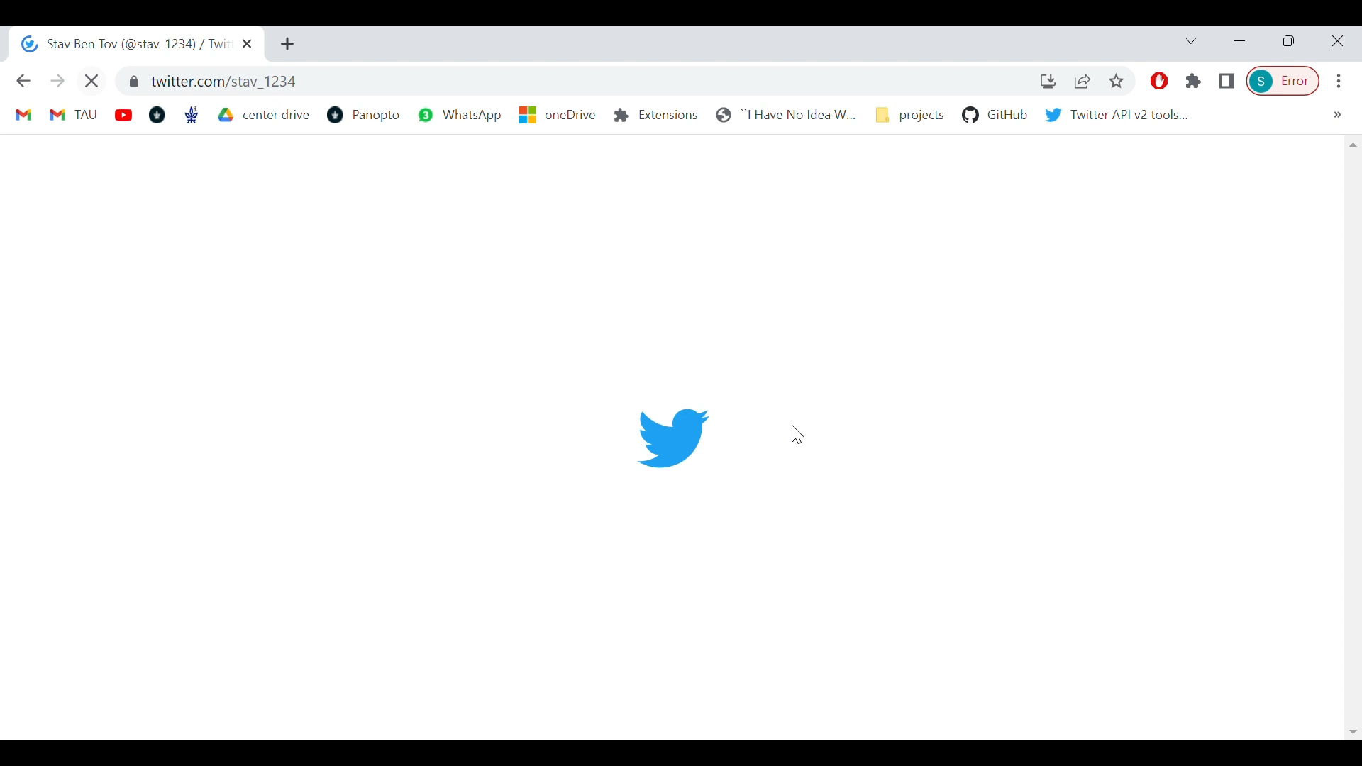
Preliminary results

Slide 12
Remaining tasks
Explore about our additional ideas for the project such as: Bot percentages in comments/likes of a tweets.
User study protocol and Technical report – July.
Fix rate-limit issue.

Slide 13
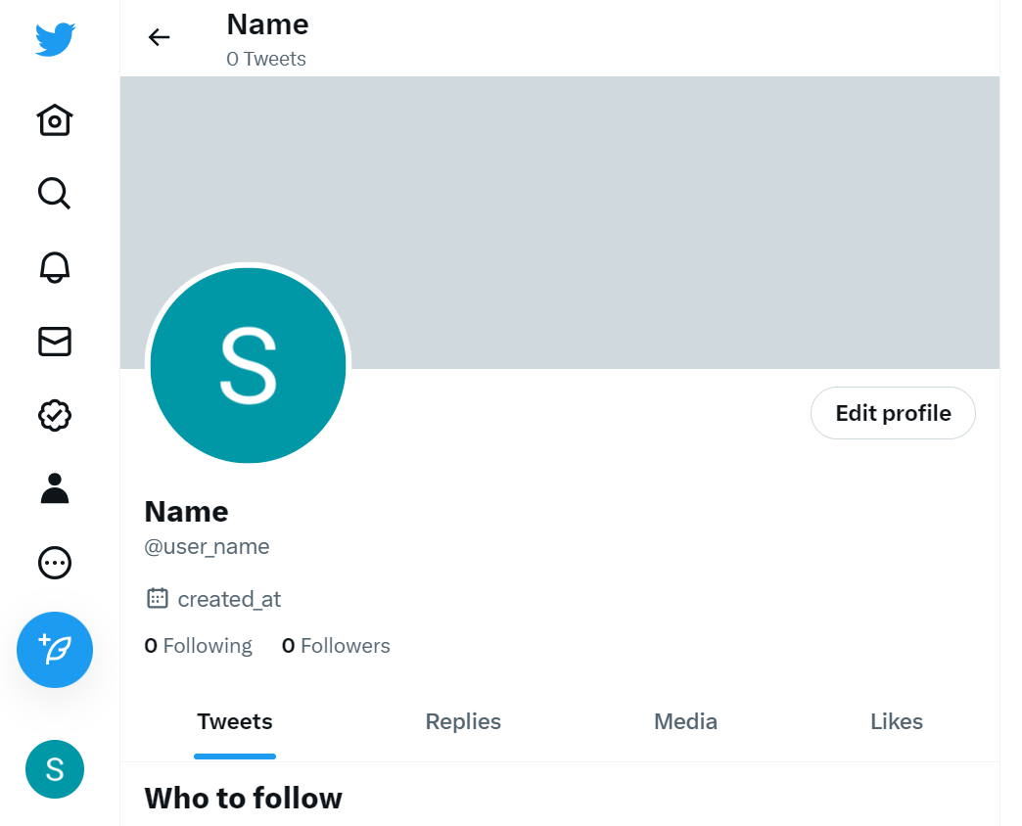
U
Is user in Local Storage?
user_name

Slide 14
U
Is user in Local Storage?
Is classification valid?
user_name
Yes

Slide 15
U
Is user in Local Storage?
Is classification valid?
Return
result
user_name
Yes
Yes

Slide 16
Make Https request to server
U
No
Is user in Local Storage?
Is classification valid?
Return
result
user_name
Yes
Yes

Slide 17
Make Https request to server
U
No
Is user in Local Storage?
Is classification valid?
Return
result
user_name
Yes
Yes

Slide 18
Is user in Global storage? (Redis)
Make Https request to server
U
No
Is user in Local Storage?
Is classification valid?
Return
result
user_name
Yes
Yes

Slide 19
Is user in Global storage? (Redis)
Make Https request to server
Yes
Is classification valid?
U
No
Is user in Local Storage?
Is classification valid?
Return
result
user_name
Yes
Yes

Slide 20
Is user in Global storage? (Redis)
Make Https request to server
Yes
Is classification valid?
U
No
Yes
Is user in Local Storage?
Is classification valid?
Return
result
user_name
Yes
Yes

Slide 21

Is user in Global storage? (Redis)
ML Model
Make Https request to server
Yes
No
Is classification valid?
U
No
Yes
Is user in Local Storage?
Is classification valid?
Return
result
user_name
Yes
Yes

Slide 22
Is user in Global storage? (Redis)
No
ML Model
Make Https request to server
Yes
No
Is classification valid?
U
No
Yes
Is user in Local Storage?
Is classification valid?
Return
result
user_name
Yes
Yes

Slide 23
Is user in Global storage? (Redis)
No
Calculating user_name
ML Model
Make Https request to server
Yes
No
Is classification valid?
U
No
Yes
Is user in Local Storage?
Is classification valid?
Return
result
user_name
Yes
Yes

Slide 24
Is user in Global storage? (Redis)
No
Calculating user_name
ML Model
Make Https request to server
Yes
No
Is classification valid?
U
No
No
Yes
Is user in Local Storage?
Is classification valid?
Return
result
user_name
Yes
Yes

Slide 25
Is user in Global storage? (Redis)
No
Calculating user_name
ML Model
Make Https request to server
Yes
No
Is classification valid?
U
No
No
Yes
Is user in Local Storage?
Is classification valid?
Return
result
user_name
Yes
Yes

Slide 26
Save result in Global Storage
Is user in Global storage? (Redis)
No
Calculating user_name
ML Model
Make Https request to server
Yes
No
Is classification valid?
U
No
No
Yes
Save result in Local Storage
Is user in Local Storage?
Is classification valid?
Return
result
user_name
Yes
Yes

Slide 27
No
Save result in Global Storage
Is user in Global storage? (Redis)
No
Calculating user_name
ML Model
Make Https request to server
Yes
Is classification valid?
U
No
No
Save result in Local Storage
Is user in Local Storage?
Is classification valid?
Return
result
user_name
Yes
Yes
Yes

Slide 28
ML Model
U
Return
result

Slide 29
ML Model
U
Return
result
user_name is bot

Slide 30

ML Model
U
Return
result
user_name is bot

Slide 31
User study
Our hypotheses:
Users who install “Bot Detective” tend to be more security-conscious and critical of the content they encounter on the web.
Online survey to gather feedback from users before and after they use the tool.
Assess:
Level of security awareness and critical behavior.
Level of Usability.

